Slide 1
Machine Learning
Group 35

Slide 2
Agenda
01
Introduction & Background
04
Results
02
05
Methodology
Discussion & Conclusion
03
Experiments / Demonstration
06
References

Slide 3
Introduction and Background
01
Feeling overwhelmed but no one to talk to?
02
What if you had instant emotional support?
03
Can a chatbot truly understand your feelings?
04
How can technology help with emotional well-being?

Slide 4
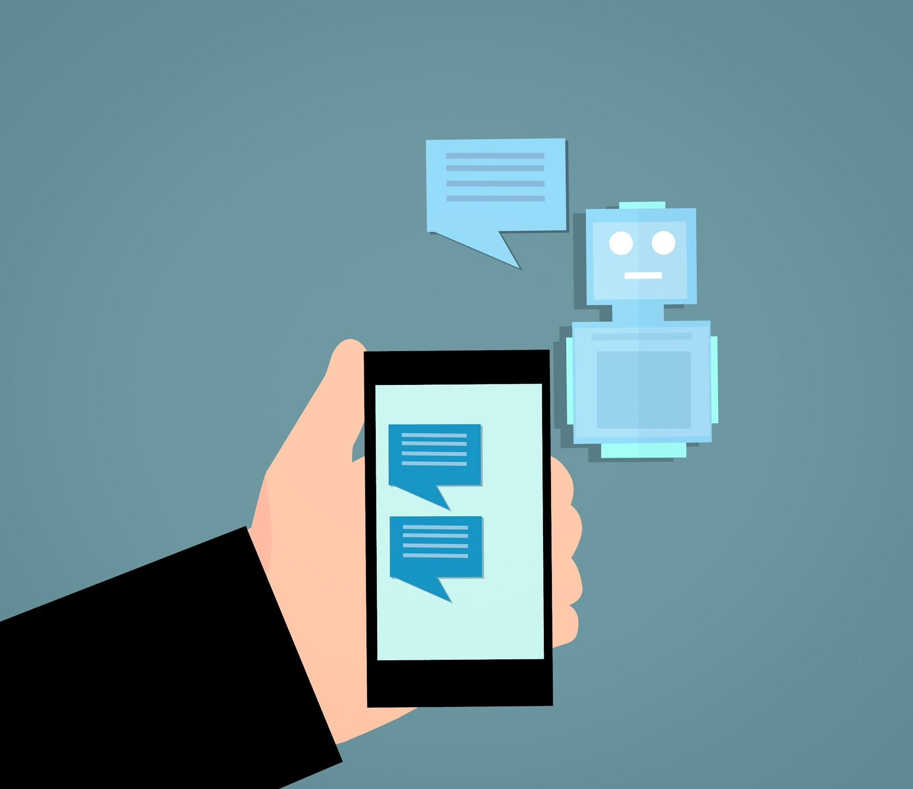

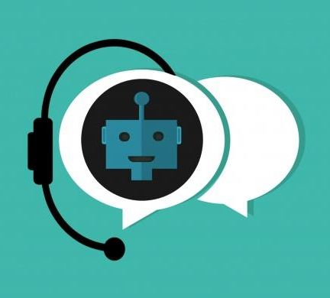
Introduction and Background
Text-based Chatbots
-rely on text communication
-lacks the ability to fully convey emotional nuances
Speech Emotion Recognition (SER)
-allows the system to detect emotions directly from voice inputs
-making interactions more natural and empathetic.
Natural Language Processing (NLP)
-respond according to the content of the conversation
-provide meaningful and context-aware feedback

Slide 5

Introduction and Background
Smart Chatbot with Emotion Recognition
Caring for your emotions
The Best Listener for Students
An Intelligent Emotion Assistant
Build a smart chatbot capable of voice conversation that can provide intelligent responses based on students' emotions

Slide 6

Methodology
Speech Emotion Recognition (SER)
Identify emotional states
EmoLingo
Chatbot Response Generation
Generate context-specific responses based on the detected emotions
Text-to-Speech (TTS)
Converts text into spoken audio
Speech-to-Text (STT)
Converts spoken audio
into text
Language Detection
Recognize speech language

Slide 7
Methodology
Speech Emotion Recognition (SER)
CNN model
EmoLingo
Chatbot Response Generation
Fine-tune GPT-3.5 API
Text-to-Speech (TTS)
XTTS-v2 model
Speech-to-Text (STT)
Google Speech Recognition
(python library)
Language Detection
Whisper model

Slide 8
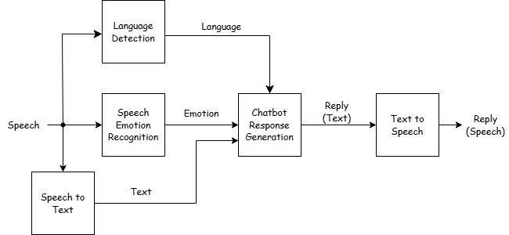
Methodology

Slide 9
Experiments / Demonstration
01
Speech Recording:
Capture user input via microphone.
02
Language Detection:
Identify the language of the input.
03
Speech-to-Text & SER:
Transcribe the audio and analyze emotions.
04
Chatbot Response:
Generate empathetic responses using GPT.
05
Text-to-Speech:
Convert text replies into audio feedback.

Slide 10
Results
01
Accurate emotion detection from voice inputs
EmoLingo
Intelligent emotional assistant
01
Intelligent chatbot
02
Appropriate text and voice responses based on emotion
Helps manage emotions through voice-based interactions
02
03
Personalized meaningful replies for the user
Provide empathetic and supportive responses
03
04
Enhanced emotional support for students in real-time
Showcase AI’s role in improving emotional well-being
04

Slide 11
Discussion & Conclusion
Achievements:
Successfully implemented a multimodal chatbot by integrating STT, SER, GPT, and TTS.
Supports 16 languages and 8 emotions, providing a human-like interaction experience.
Supports personalized and multilingual interactions.
Limitations:
SER accuracy and chatbot response require further refinement.
Response time is a little slow, requiring at least 1 minute per interaction.
Future Directions:
Enhanced models for improved accuracy.
Optimized pipelines for faster response.
Develop a user-friendly interface (UI).
Offer multiple chatbot voice options for personalization.

Slide 12
References
[1] M. A. Hamid, “Speech emotion recognition 97.25% accuracy” Kaggle, Oct. 2024. [Online]. Available: https://www.kaggle.com/code/mostafaabdlhamed/speech-emotion-recognition-97-25-accuracy/notebook
[2] coqui-ai Developers, “TTS” GitHub repository, Nov. 24, 2023. [Online]. Available: https://github.com/coqui-ai/TTS
[3] openai Developers, “whisper” GitHub repository, Oct. 2024. [Online]. Available: https://github.com/openai/whisper
[4] ChatAnywhere and Nauxscript, “GPT_API_free” GitHub repository, Nov. 2024. [Online]. Available: https://github.com/chatanywhere/GPT_API_free/tree/main
[5] K. Chaovavanich, “Record audio in Colab using getUserMedia({audio: true})” Github Gist, Jul. 2023. [Online]. Available: https://gist.github.com/korakot/c21c3476c024ad6d56d5f48b0bca92be?permalink_comment_id=3691958

Slide 13
THE END
Thank You For Listening~

